Slide 1
Chemistry – Sept 5, 2019
P3 Challenge –
Perform the following operations and round to the proper number of sigfigs.
  A) 7.53 m x 1.3 m
  B) 85.36 m – 6.2 m
Finish and Hand in Measurement Lab activity (if not done yet) on my desk
Get out Density WS for a HMK check
Pick up Metric WS

Slide 2
Objectives and Agenda
Objectives
  To Use the Metric System
Agenda
  SI Units
  The Metric System
  3 Unit Conversion methods
  The Ladder
  Powers of 10
  Dimensionalysis

Slide 3
SI (metric) System
BASE UNITS (all defined relative to the 3 standards above)
  meter for length
  kilogram for mass (note: not the gram)
  second for time
  ampere for electric current
  kelvin for temperature
  candela for luminous intensity
  mole for the amount of substance
DERIVED UNITS
  liter for volume (1 mL = 1 cm³)
PREFIXES (Memorize these 5 for convenience)
  Allows units to be a convenient size for observations
Prefix | Abbreviation | Power of 10
Kilo- | k | 10³
Deci- | d | 10⁻¹
Centi- | c | 10⁻²
Milli- | m | 10⁻³
Micro- | μ | 10⁻⁶

Slide 4
The mole concept
The mole allows us to connect the macroscopic and atomic scales.
  (An instance of the CCC Scale, Proportion and Quantity)
A mole is a unit like dozen or ream.
A mole simply counts some number of items.
So…how many is a mole?
1 mole = 6.022 x 10²³ There are 6.022 x 10²³ items in one mole of anything.

Slide 5
Complete Set of Prefixes
Prefix | Symbol | Meaning | Example
tera | T | 1 000 000 000 000 or 10¹² | 1 Ts = 1 000 000 000 000 s = 10¹² s
giga | G | 1 000 000 000 or 10⁹ | 1 Gs = 1 000 000 000 s = 10⁹s
mega- | M | 1 000 000 or 10⁶ | 1 Ms = 1 000 000 s = 10⁶ s
kilo- | k | 1 000 or 10³ | 1 ks = 1000 s = 10³ s
deci- | d | 0.1 or 10⁻¹ | 1 ds = 0.1 s = 10⁻¹ s
centi- | c | 0.01 or 10⁻² | 1 cs = 0.01 s = 10⁻² s
milli- | m | 0.001 or 10⁻³ | 1 ms = 0.001 s = 10⁻³ s
micro- | µ | 0.000 001 or 10⁻⁶ | 1 µs = 0.000 001 s = 10⁻⁶ s
nano- | n | 0.000 000 001 or 10⁻⁹ | 1 ns = 0.000 000 001 s = 10⁻⁹ s
pico- | p | 0.000 000 000 001 or 10⁻¹² | 1 ps = 0.000 000 000 001 s = 10⁻¹² s

Slide 6
Converting Method 1 – Move decimal
¹²
T
G
M
k
Base
d
c
m
µ
n
Imagine the list of prefixes as a ladder. For each step on the ladder from your starting unit to your target unit, you will move your decimal one place.
If you move to a larger unit, UP the ladder, the number will get smaller. Move decimal to left.
If you move to a smaller unit, DOWN the ladder, the number will get larger. Move decimal to right.
Smaller unit needs bigger number. Bigger unit needs smaller number.
Ex: 945 mL → L (Small unit to larger unit, move decimal left 3)
Ex: 3.5 kg → mg (Large unit to smaller unit, move decimal right…)
Ex: 25.32 m² → cm² (Convert both dimensions)
⁹
⁶
³
⁰
⁻¹
⁻²
⁻³
⁻⁶
⁻⁹

Slide 7
Converting method 2 – Powers of 10
Each of the prefix labels can be considered a variable that has the value of its defined power of 10.
You may replace 10³ with k.
You may replace k with 10³.
Convenient to use if values are in scientific notation
Ex: 3.4 x 10² nm → m ( n means 10⁻⁹) 3.4 x 10² x 10⁻⁹ m = 3.4 x 10⁻⁷ m
Ex: 4.78 x 10⁻² m → cm (Target needs 10⁻²) 4.78 x 10⁻² m = 4.78 cm
Ex: 3.58 x 10⁻⁴ cm → μm (Target needs 10⁻⁶ m) 3.58 x 10⁻⁴ x 10⁻² m= 3.58 x 10⁻⁶ m = 3.58 μm
Trick: If you don’t have the powers of 10 you need, you can multiply by a special form of 1
  Ex: (10⁻³ x 10³) = 10⁰ = 1 or Ex: (10⁻⁶ x 10⁶) = 10⁰ = 1
  Ex: 6.13 x 10⁻⁵ mg → kg (Target needs 10³) 6.13 x 10⁻⁵ x 10⁻³ x (10³ x 10⁻³) g = 6.13 x 10⁻¹¹ kg

Slide 8
Metric Conversions Practice
Ex: 452 mm → m
Ex: 6.78 x 10⁻⁷ km → m
Ex: 5.7 x 10⁻⁹ L → μL
Ex: 2.3 L → mL
Ex: 0.0000213 km → mm
Ex: 1.05 x 10⁵ km² → m²
If you’ve got scientific notation, the power of 10 method is going to work best.
If you’ve got standard notation, the ladder moving decimals method is going to work best.

Slide 9
Conversion Method 3 – Dimensionalysis
Also called the factor label method
Ex: How many individual eggs are there in 22 dozens of eggs?
12
eggs
22 dozen
= 264 eggs
1
dozen
Valid process because all conversion factors = 1.

Slide 10
Conversion Method 3 – Dimensionalysis
Write the measured value with its unit. (Given)
Draw the multiplication symbol and a division line.
Copy the unit to the bottom of the conversion factor to cancel.
“Times sign, draw a line, copy the unit”
Write the target unit on the top of the conversion factor.
Find an equivalence using these two units and complete the conversion factor.
Multiply and cancel units. (Multiply by tops, divide by bottoms)
Report value with the target unit. (Use correct sigfigs)

Slide 11
Meter Stick Equivalences
Three equivalences are used often in conversion factors
They are called the meter stick equivalences because they all relate to the meter stick
  Easy to visualize and remember.
Also works for other base units: 1000 mL = 1 L
1 m = 100 cm
1 m = 1000 mm
1000 m = 1 km

Slide 12
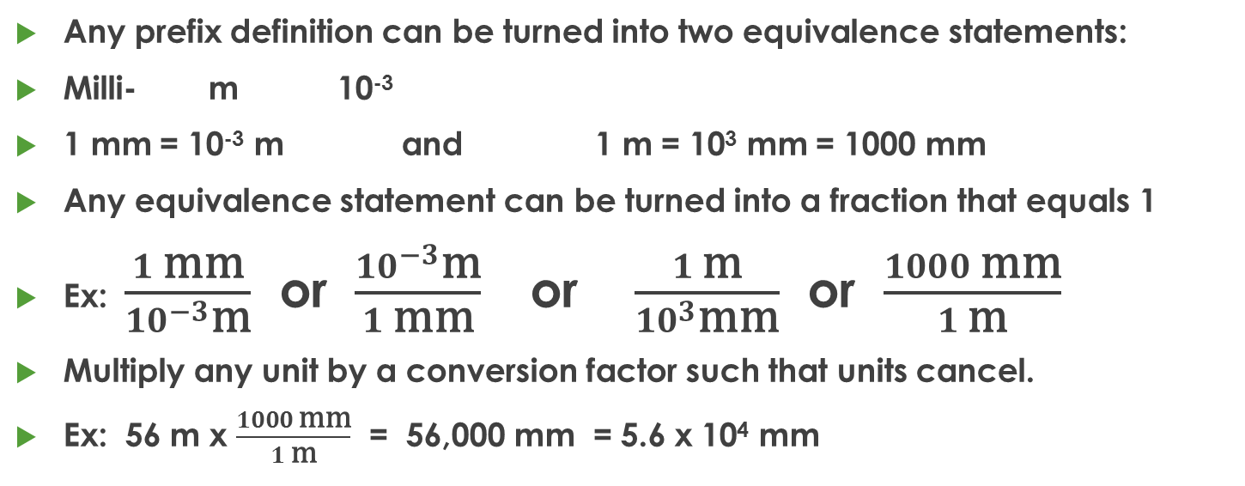
Conversion Method 3 – Dimensionalysis
Any prefix definition can be turned into two equivalence statements:
Milli- m 10⁻³
1 mm = 10⁻³ m and 1 m = 10³ mm = 1000 mm
Any equivalence statement can be turned into a fraction that equals 1
Ex: $\frac{1 \text{mm}}{{10}^{−3}\text{m}}$ or $\frac{{10}^{−3}\text{m}}{1 \text{m}\text{m}}$ or $\frac{1 \text{m}}{{10}^{3}\text{m}\text{m}}$ or $\frac{1000 \text{m}\text{m}}{1 \text{m}}$
Multiply any unit by a conversion factor such that units cancel.
Ex: 56 m x $\frac{1000 \text{mm}}{1 \text{m}}$ = 56,000 mm = 5.6 x 10⁴ mm

Slide 13
Practice with Conversion factors
“Times sign, draw a line, copy the unit”
Ex: 73 cm → m
Ex: 3.55 L → mL
Ex: 0.359 g → mg
Ex: 5.8 μm → mm
  Think 5.8 μm → m → mm (use two conversion factors)

Slide 14
Exit Slip - Homework
Order the following metric units from largest to smallest:
μm , cm, km, m, mm, nm, Mm
What’s Due? (Pending assignments to complete.)
  Complete the Metric Conversions Worksheet
What’s Next? (How to prepare for the next day)
  Read p12-16 Factor Label Method

